Slide 1

8, 9, 10, 11 …
The current state and future of Java
Panche Chavkovski
2018-03-31 / #JavaSkop

Slide 2
Disclaimer
Release plans and ideas for syntax changes are portrayed as last communicated
Some of the current stats, the proposed feature sets and the accompanying examples are as presented by the Java Architects Mark Reinhold and Brian Goetz (copyrights might apply) in their “Moving Java Forward” talks
The Oracle JDK path is deduced from various e-mail lists, talks and posts by CodeFX Weekly by Nicolai Parlog.

Slide 3
Raise of hands
What’s you current Java flavor?

Slide 4
Java 9
Jigsaw
JLink
JShell
Immutable collections factory methods
Streaming API improvements
Process API improvements
HTTP/2 client
Concurrency updates
…

Slide 5
#worksFineOnJDK9
Akka Ant Camel Commons Lang Eclipse IDE Elasticsearch Gradle Hibernate IntelliJ IDEA Jackson Jersey
jOOQ Jrebel Junit Kafka Log4J Maven Mockito Netty RabbitMQ Spring Framework and Spring Boot Wildfly

Slide 6
speed++
Java evolving faster!

Slide 7
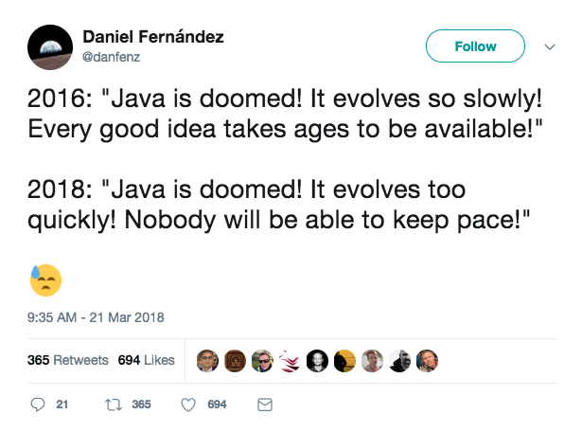

Slide 8
New release model
No more rare big feature releases
Small improvements will not wait for the heavier ones
Release happening on strict time base
Feature sets will be ‘whatever is finished’
No long lasting consequences if a feature is delayed

Slide 9
New release model
9
10
11
12
13
14
15
16
17
18
11 LTS
17 LTS
Mar’18
Sep’18
Mar’19
Sep’19
Mar’20
Sep’20
Mar’21
Sep’21
Mar’22
Sep’22

Slide 10
New release model
Don’t (necessarily) wait for the LTS releases
Do not fall in the same slow evolution trap
Upgrade slowly in time, to prepare for the next LTS
Faster, smaller or bigger releases
No rules on this. See ‘whatever is finished’.
Something may always be removed.
Always check deprecations and warnings

Slide 11
Oracle changes too
Or maybe say bye-bye to your ‘default’ JDK

Slide 12
OpenJDK and Oracle JDK
Oracle will move OpenJDK much closer to Oracle JDK
Oracle will ship, build & test GPL OpenJDK as well
Oracle will open-source their commercial features
Oracle will lead and contribute in feature (and update) releases
As of Java11, Oracle will ship commercial Advanced JavaSE
Oracle will continue support on JDK8 till Jan’19

Slide 13
Oracle JDK timeline

Slide 14
So what’s new?
And what’s with this Java 10 thing?

Slide 15
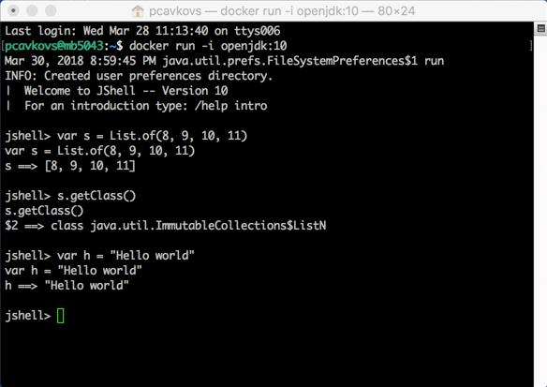
You can now do this

Slide 16
JDK 10 features
JEP 286: Local-Variable Type Inference JEP 296: Consolidate the JDK Forest into a Single Repository JEP 304: Garbage-Collector Interface JEP 307: Parallel Full GC for G1 JEP 310: Application Class-Data Sharing JEP 312: Thread-Local Handshakes JEP 313: Remove the Native-Header Generation Tool (javah) JEP 314: Additional Unicode Language-Tag Extensions JEP 316: Heap Allocation on Alternative Memory Devices JEP 317: Experimental Java-Based JIT Compiler (Graal) JEP 319: Root Certificates JEP 322: Time-Based Release Versioning

Slide 17
Local-Variable type inference
// This: URL url = new URL(”") URLConnection conn = url.openConnection(); Reader reader = new BufferedReader( new InputStreamReader(conn.getInputStream()));
// Turns into var url = new URL(”") var conn = url.openConnection(); var reader = new BufferedReader( new InputStreamReader(conn.getInputStream()));

Slide 18
Local-Variable type inference
What’s NOT inferred
var s = null;
var f = (Integer s) -> {s.toString();}
int someFunction(var dynamicArgument) { … }

Slide 19
Where is this relationship going?
What is to be expected in the future?

Slide 20
Plans for the future
OpenJDK projects (http://openjdk.java.net/projects/)
…
Metropolis: Java-on-Java VM
Amber: Right-Sizing Language Ceremony
Valhalla: Value Types and Specialized Generics
…
JDK Enhancement Proposals, a.k.a. JEPs (http://openjdk.java.net/jeps/0)

Slide 21
Project Amber
Making Java look gooood

Slide 22
Records
class Point { final double x, y; Point(double x, double y) {…} double x(){…} double y(){…} double equals(Object o) {…} double hashCode() {…} double toString() {…} }
// Yes, Lombok can help, I know...

Slide 23
Records
// In a future Java version
record Point(double x, double y);

Slide 24
Records
// Even extend it
record Point(double x, double y) { double getNorm() { return Math.sqrt(x*x + y*y); } // Not allowed // double z; }

Slide 25
Type-test pattern
interface Expr {} record Constant(int value) imlements Expr; record Add(Expr left, Expr right) imlements Expr; record Multiply(Expr left, Expr right) imlements Expr; int eval(Expr e) { if (e instanceof Constant) { Constant c = (Constant)e; return c.value(); } else if (e instanceof Add) { Add a = (Add)e; return eval(a.left()) + eval(a.right()); } else if (e instanceof Multiply) { Multiply m = (Multiply)e; return eval(a.left()) * eval(a.right()); } throw new IllegalArgumentException(); }

Slide 26
Type-test pattern
interface Expr {} record Constant(int value) imlements Expr; record Add(Expr left, Expr right) imlements Expr; record Multiply(Expr left, Expr right) imlements Expr; int eval(Expr e) { switch (e) { case Constant c: return c.value(); case Add a: return eval(a.left()) + eval(a.right()); case Multiply m: return eval(a.left()) * eval(a.right()); default: throw new IllegalArgumentException(); } }

Slide 27
Type-test pattern
interface Expr {} record Constant(int value) imlements Expr; record Add(Expr left, Expr right) imlements Expr; record Multiply(Expr left, Expr right) imlements Expr; int eval(Expr e) { return switch (e) { case Constant c -> c.value(); case Add a -> eval(a.left()) + eval(a.right()); case Multiply m -> eval(a.left()) * eval(a.right()); default: throw new IllegalArgumentException(); } }

Slide 28
Type-test pattern
sealed interface Expr {} record Constant(int value) imlements Expr; record Add(Expr left, Expr right) imlements Expr; record Multiply(Expr left, Expr right) imlements Expr; int eval(Expr e) { return switch (e) { case Constant c -> c.value(); case Add a -> eval(a.left()) + eval(a.right()); case Multiply m -> eval(a.left()) * eval(a.right()); } }

Slide 29
Type-test pattern with extraction
sealed interface Expr {} record Constant(int value) imlements Expr; record Add(Expr left, Expr right) imlements Expr; record Multiply(Expr left, Expr right) imlements Expr; int eval(Expr e) { return switch (e) { case Constant(int value) -> value; case Add a(Expr left, Expr right) -> eval(left) + eval(right); case Multiply(Expr left, Expr right) -> eval(left) * eval(right); } }

Slide 30
Type-test pattern with value extraction
sealed interface Expr {} record Constant(int value) imlements Expr; record Add(Expr left, Expr right) imlements Expr; record Multiply(Expr left, Expr right) imlements Expr; int eval(Expr e) { return switch (e) { case Constant(int value) -> value; case Add a(Expr left, Expr right) -> eval(left) + eval(right); case Multiply(Expr left, Constant(0)) -> new Constant(0); case Multiply(Expr left, Constant(1)) -> eval(left); case Multiply(Constant(0), Expr right) -> new Constant(0); case Multiply(Constant(1), Expr right) -> eval(right); case Multiply(Expr left, Expr right) -> eval(left) * eval(right); } }

Slide 31
Type-test pattern with value extraction
sealed interface Expr {} record Constant(int value) imlements Expr; record Add(Expr left, Expr right) imlements Expr; record Multiply(Expr left, Expr right) imlements Expr; int eval(Expr e) { return switch (e) { case Constant(int value) -> value; case Add a(Expr left, Expr right) -> eval(left) + eval(right); case Multiply(_, Constant(0)) -> new Constant(0); case Multiply(Expr left, Constant(1)) -> eval(left); case Multiply(Constant(0), _) -> new Constant(0); case Multiply(Constant(1), Expr right) -> eval(right); case Multiply(Expr left, Expr right) -> eval(left) * eval(right); } }

Slide 32
Project Valhalla
Throwing the trash in the trash

Slide 33
Arrays and trashing in Java
Object Arrays (and Collections) in Java are not memory efficient
A lot of pointers, a lot of headers
Memory trashing
CPU clogging
Low performance

Slide 34
Arrays in memory
Point []p =
header
[0]
[1]
[2]
[3]
[4]
header
x
y
header
x
y
header
x
y
header
x
y
header
x
y

Slide 35
Arrays in memory
Point []p =

Slide 36
Value types
value record Point(double x, double y);
Explode the record contents directly into the arrays
Get rid of pointers and consecutive headers
More like a C ‘struct’ flavored approach
The language will still report it as an immutable record
with some adversaries …

Slide 37
Arrays in memory
Point []p =
header
[0].x
[0].y
[1].x
[1].y
[2].x
[2].y
[3].x
[3].y
…

Slide 38
And as a consequence
// Instead of value record OptimizedInt(int i); OptimizedInt []array; ArrayList<OptimizedInt> list; // Do this ArrayList<int> primitiveIntList;

Slide 39
Discussion

Slide 40
Resources
Moving Java Forward faster by Mark Reinhold: https://mreinhold.org/blog/forward-faster
Radical new plans for Java by Nicolai Parlog: https://medium.com/codefx-weekly/radical-new-plans-for-java-5f237ab05b0
How project Amber will revolutionize Java: https://www.sitepoint.com/project-amber-will-revolutionize-java/
No free LTS versions by Nicolai Parlog: https://medium.com/codefx-weekly/no-free-java-lts-version-b850192745fb
Moving Java Forward Faster by Mark Reinhold @ Jfokus’18: https://www.youtube.com/watch?v=H48QEcjP1PU
Java Language Features by Brian Goetz @ Devoxx’17: https://www.youtube.com/watch?v=qul2B8iPC-o

